Slide 1
iOS watching you: Automated analysis of “zero-touch” privacy violations under iOS
Benjamin Altpeter, 2021-08-03

Slide 2
Quick recap
TODO

Slide 3

Method
Image: Jeswin Thomas (Unsplash license)

Slide 4
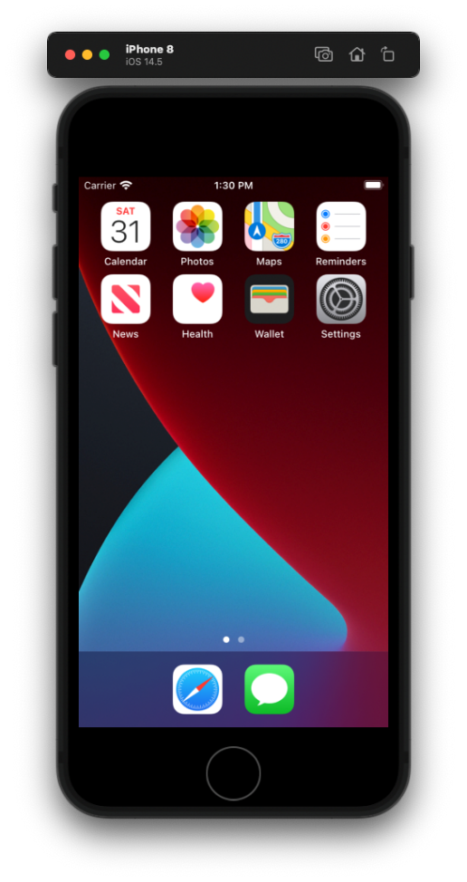
Is emulation an option?

Slide 5
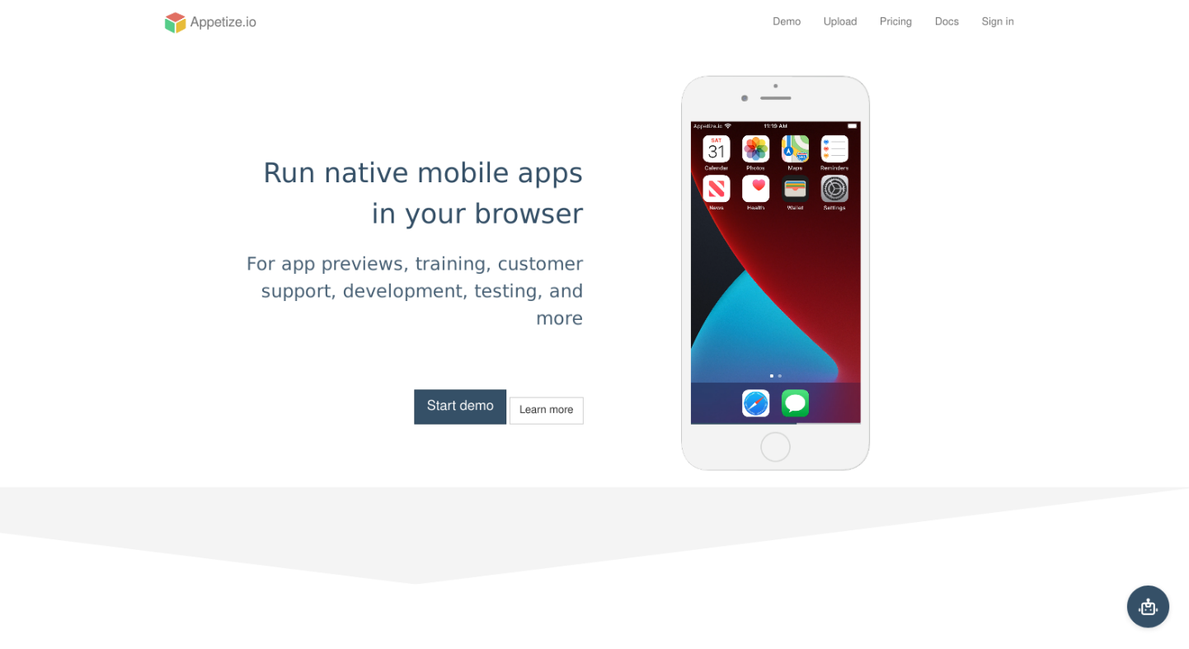
Maybe commercial providers can help?
https://appetize.io/

Slide 6
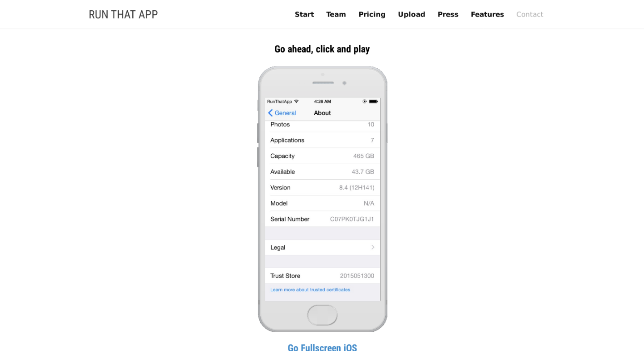
Maybe commercial providers can help?
https://www.runthatapp.com/demo/

Slide 7
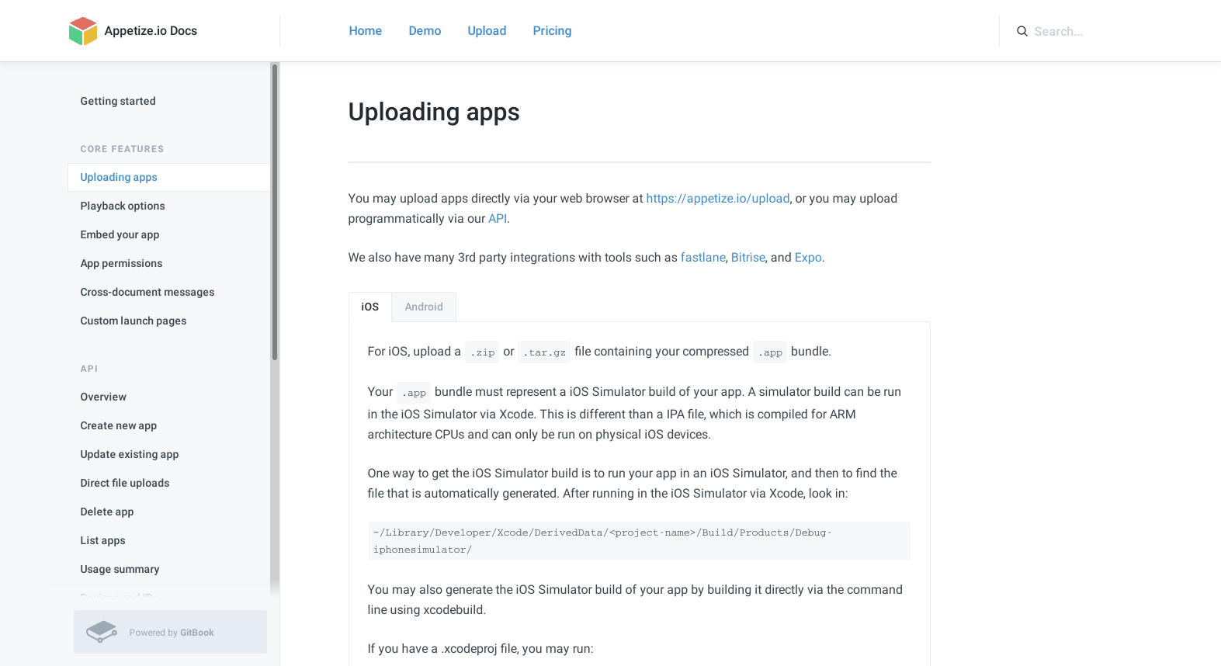
Maybe commercial providers can help?
https://docs.appetize.io/core-features/uploading-apps

Slide 8
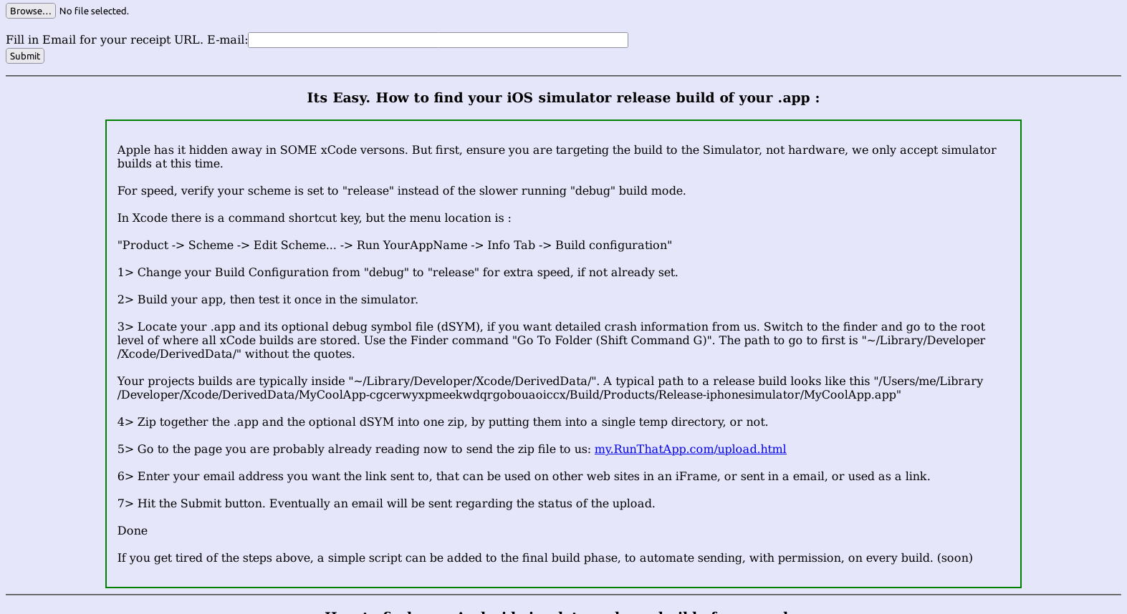
Maybe commercial providers can help?
http://upload.runthatapp.com/upload.html

Slide 9
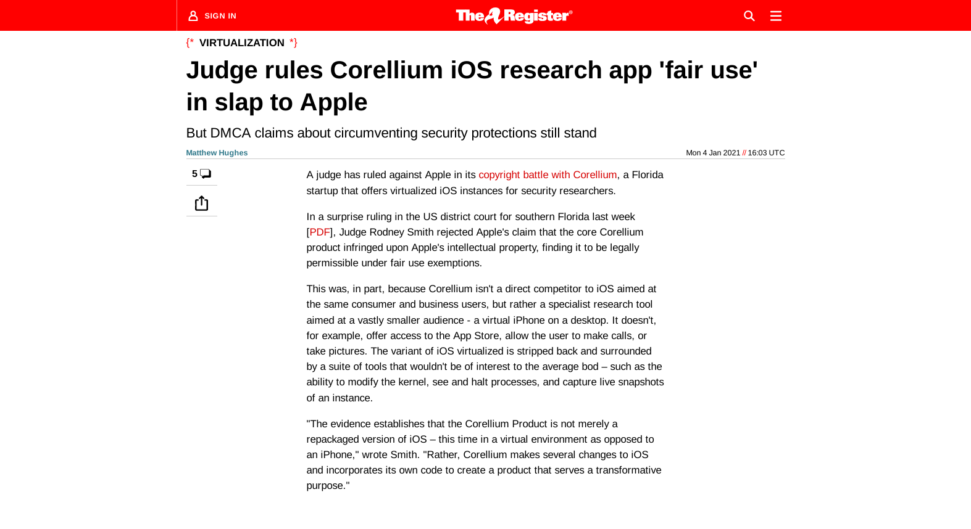
What about Corellium?
https://www.theregister.com/2021/01/04/corellium_ios_ruling/

Slide 10
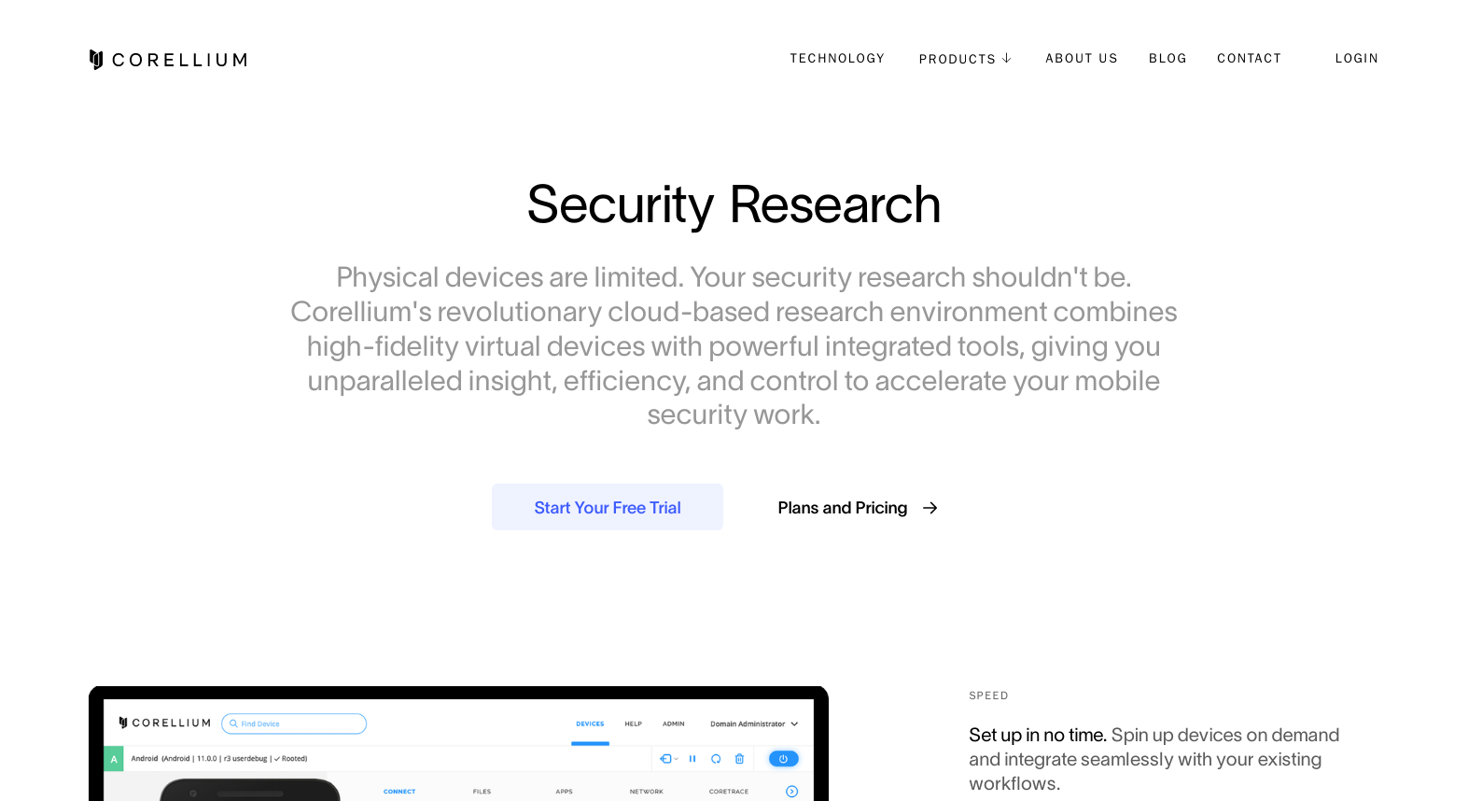
What about Corellium?
https://corellium.com/security-research

Slide 11
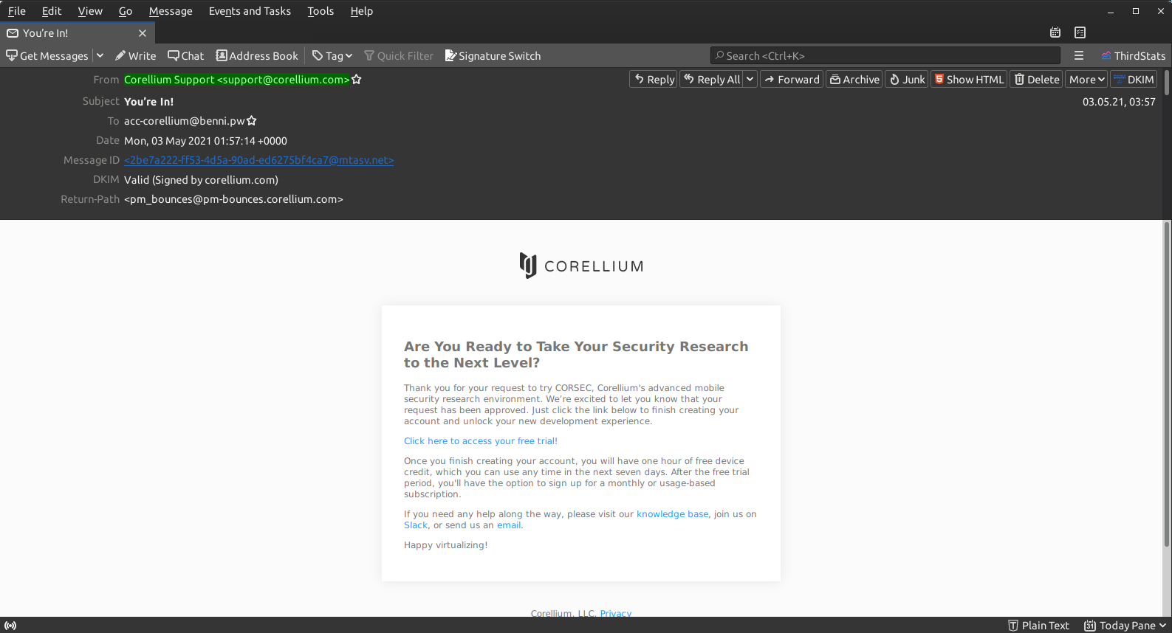
I’m in!

Slide 12
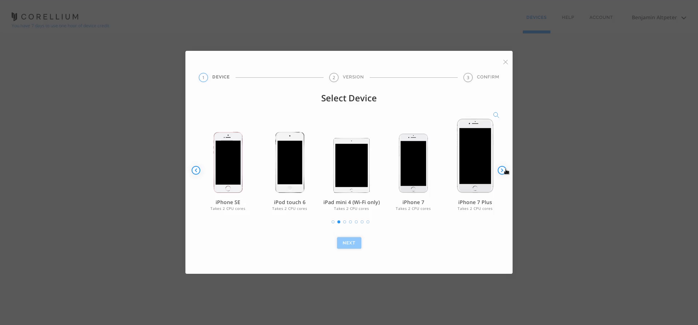
I’m in!
https://app.corellium.com/

Slide 13
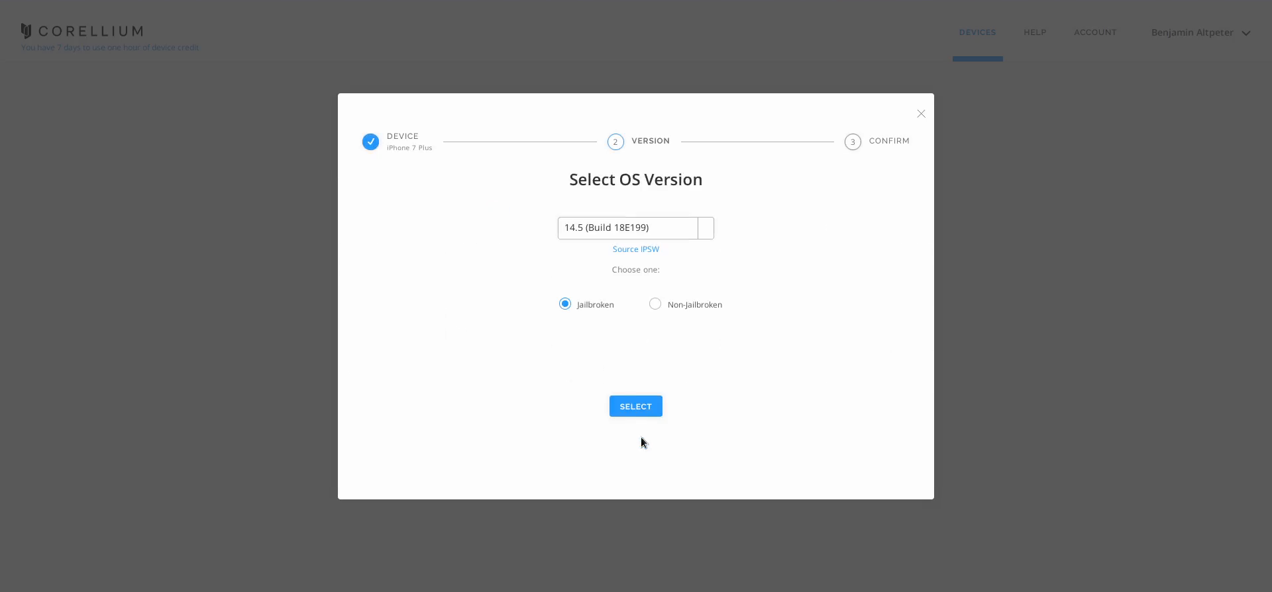
I’m in!
https://app.corellium.com/

Slide 14
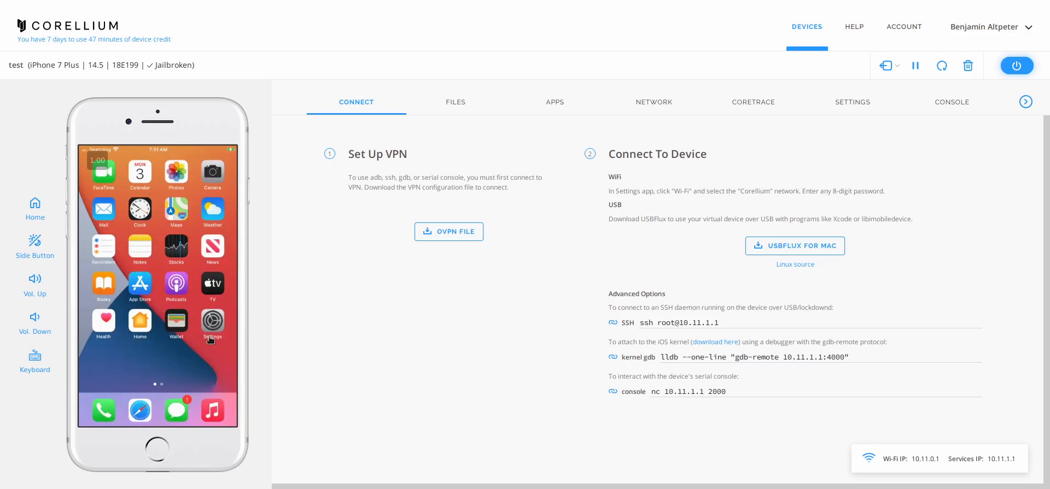
I’m in!
https://app.corellium.com/

Slide 15
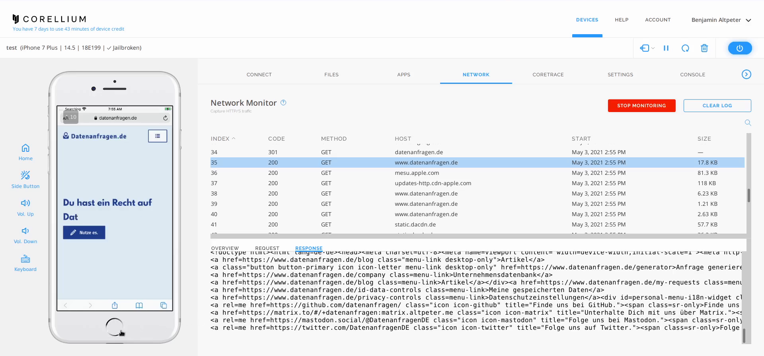
I’m in!
https://app.corellium.com/

Slide 16
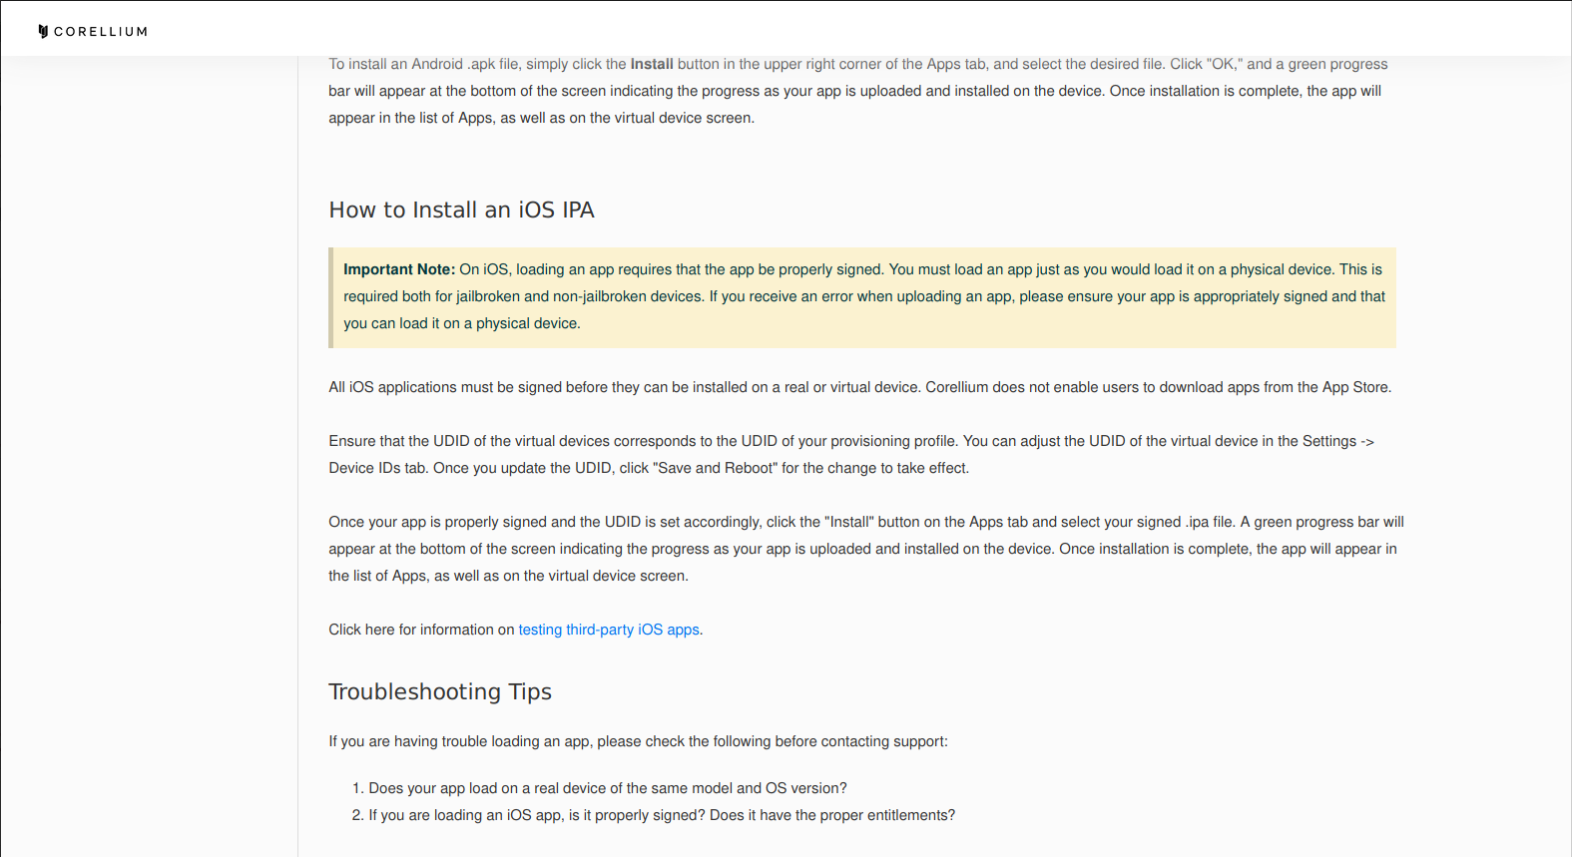
Another dead end
https://support.corellium.com/hc/en-us/articles/360051662354-Apps

Slide 17

Let’s make the device usable
https://checkra.in/

Slide 18
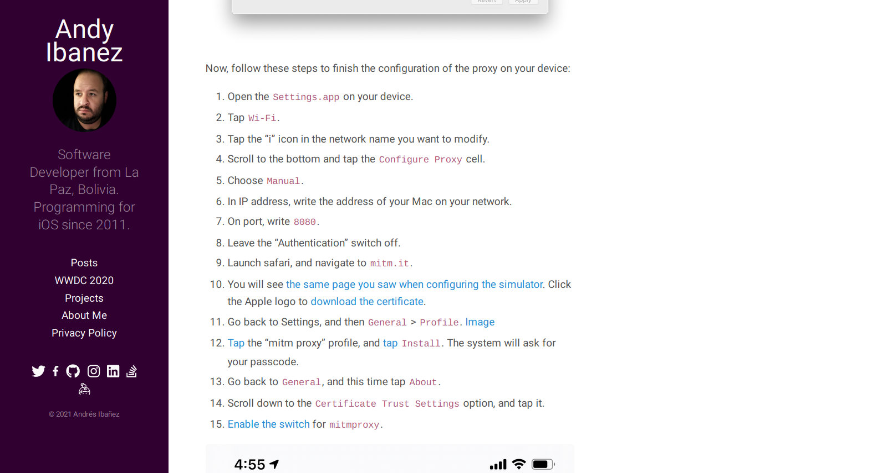
Surprisingly easy…
https://www.andyibanez.com/posts/intercepting-network-mitmproxy/#physical-ios-devices

Slide 19
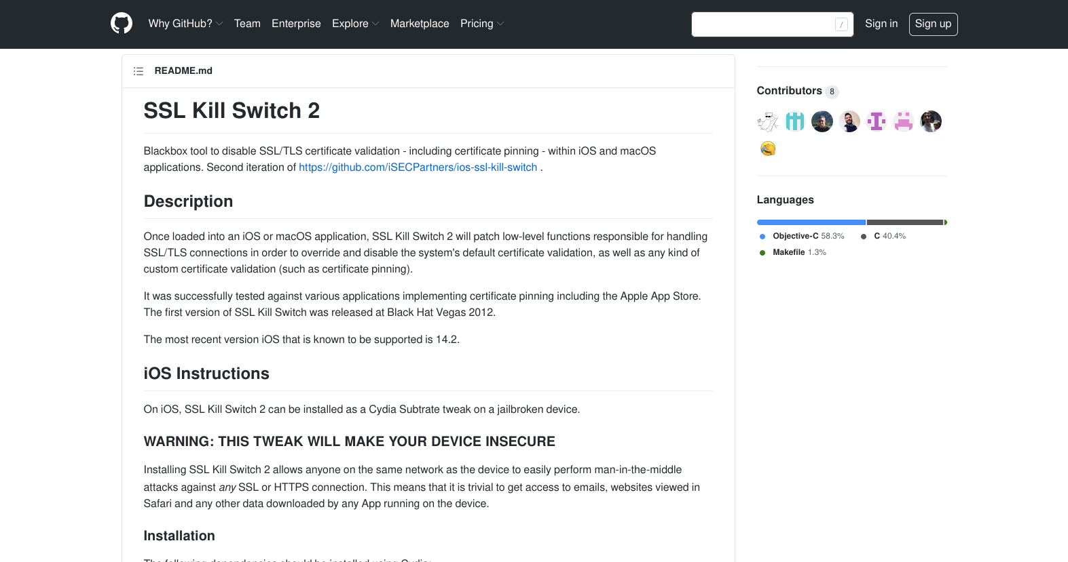
Surprisingly easy…
https://github.com/nabla-c0d3/ssl-kill-switch2

Slide 20
Obtaining apps
<?xml version="1.0" encoding="UTF-8"?> <!DOCTYPE plist PUBLIC "-//Apple//DTD PLIST 1.0//EN"
"http://www.apple.com/DTDs/PropertyList-1.0.dtd"> <plist version="1.0"> <dict> <!-- […] --> <key>artistName</key> <string>AMZN Mobile LLC</string> <key>bundleDisplayName</key> <string>Amazon Alexa</string> <!-- […] --> <key>storeCohort</key> <string>7|date=1622133000000&amp;sf=143443</string> <key>appleId</key> <string>frank.walther.1978@icloud.com</string> <key>aiBuy</key> <true/> </dict> </plist>

Slide 21
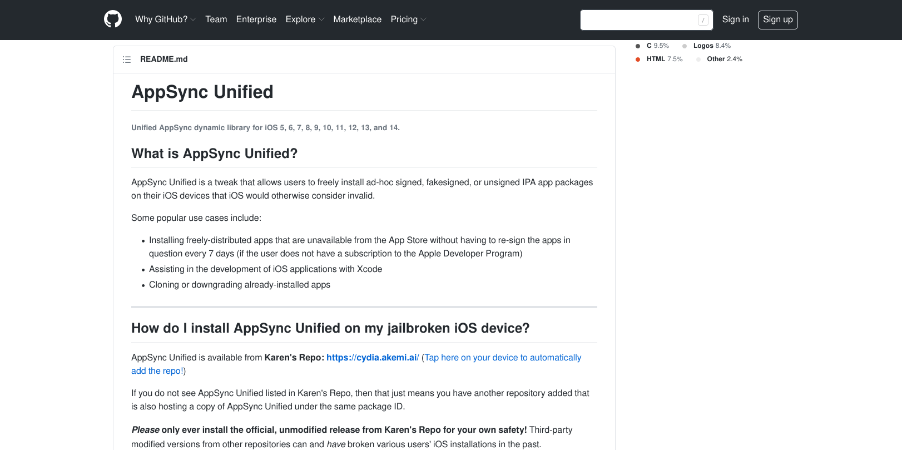
Obtaining apps
https://github.com/akemin-dayo/AppSync

Slide 22
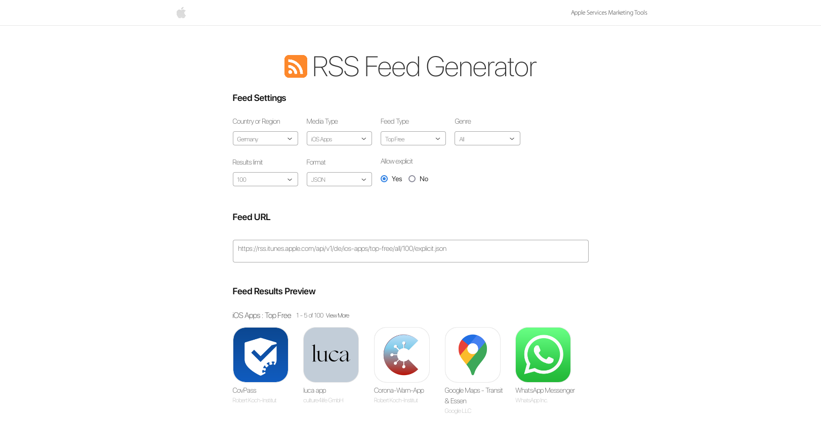
Let’s start with a wish list
https://rss.itunes.apple.com/en-us

Slide 23
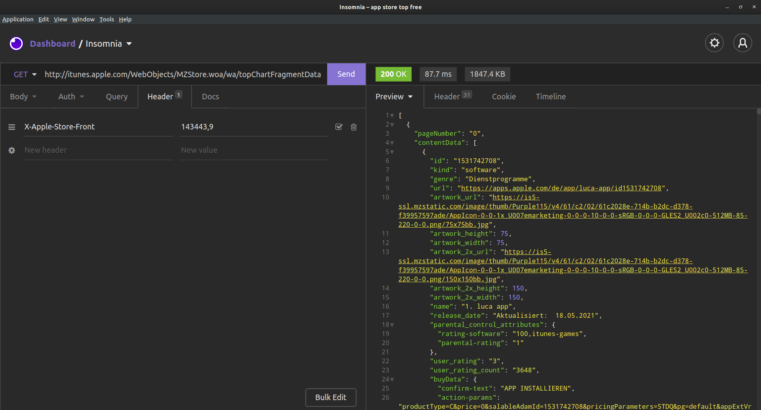
Backwards compatibility to the rescue
http://itunes.apple.com/
WebObjects/MZStore.woa/wa/topChartFragmentData
?cc=de&genreId=36&popId=27
&pageSize=120&pageNumbers=0,1,2,3,4,5,6,7,8,9

Slide 24
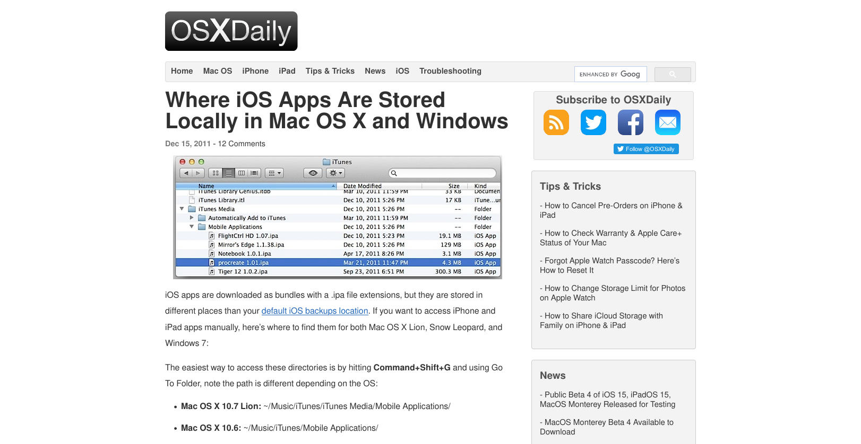
Officially supported?
https://osxdaily.com/2011/12/15/where-ios-apps-stored-locally-in-mac-os-x-and-windows/

Slide 25
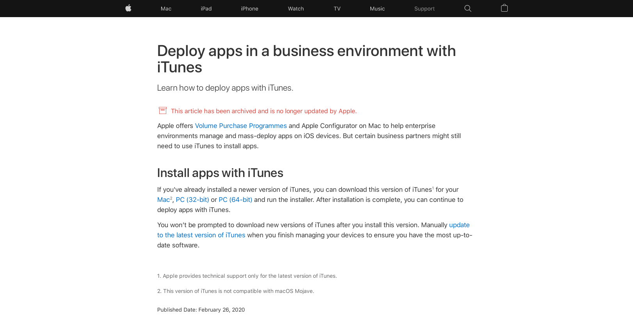
Officially supported?
https://support.apple.com/en-gb/HT208079

Slide 26
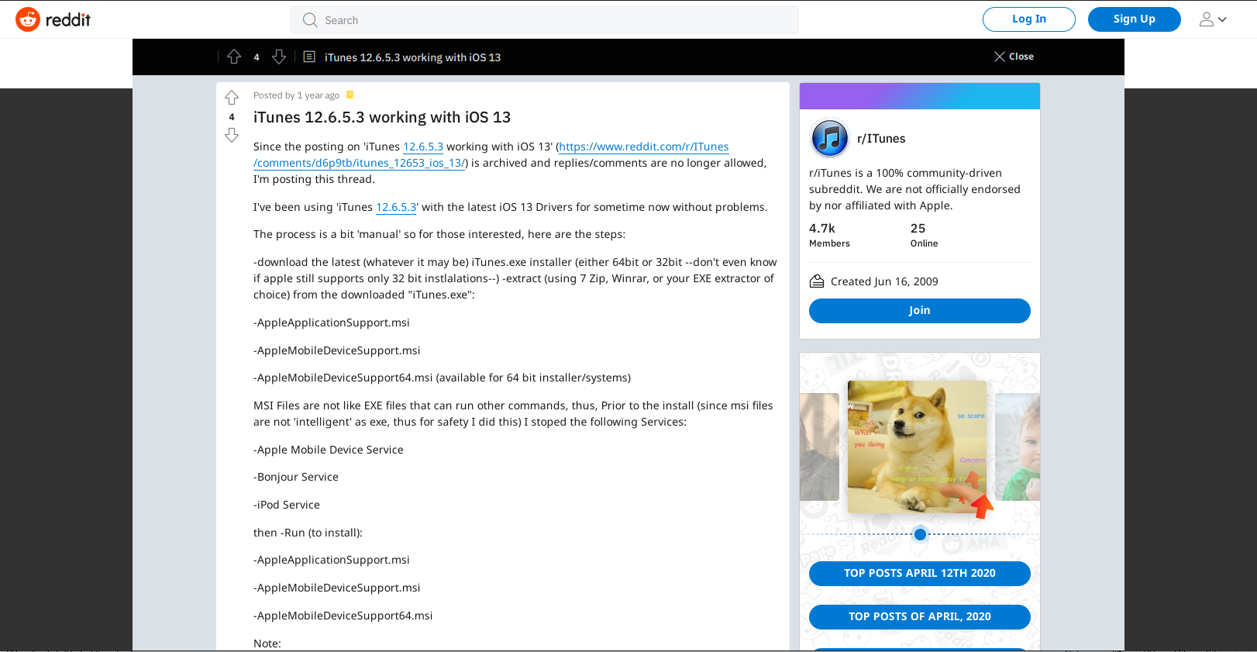
How about not so officially supported?
http://web.archive.org/web/20210527200153if_/https://www.reddit.com/r/ITunes/comments/g01qqh/itunes_12653_working_with_ios_13/

Slide 27
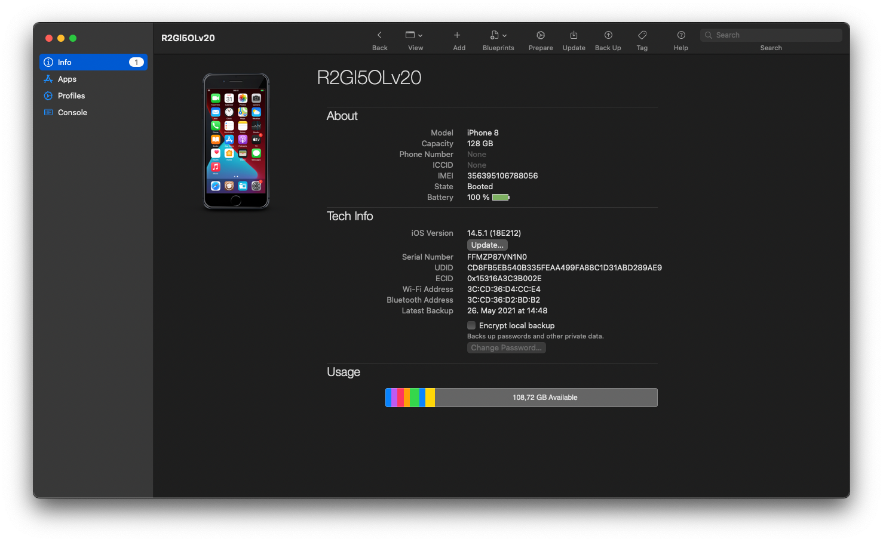
Officially supported 2.0

Slide 28
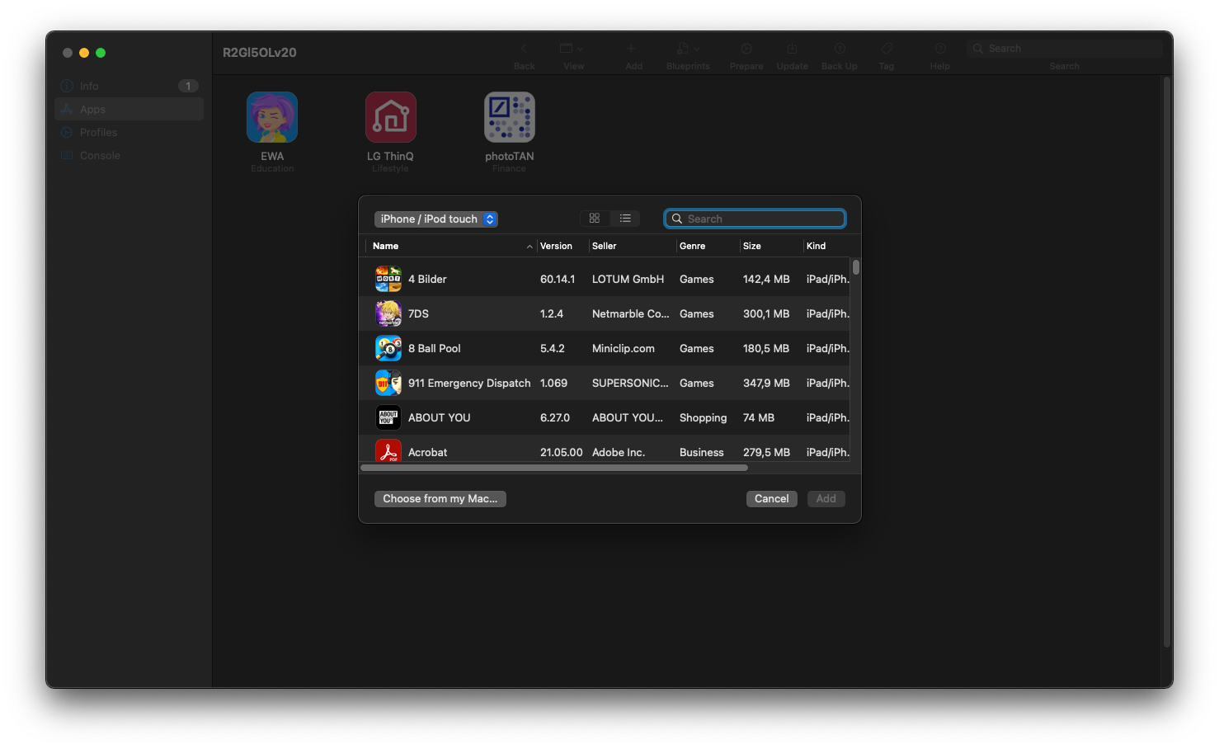
Officially supported 2.0—not quite, though

Slide 29
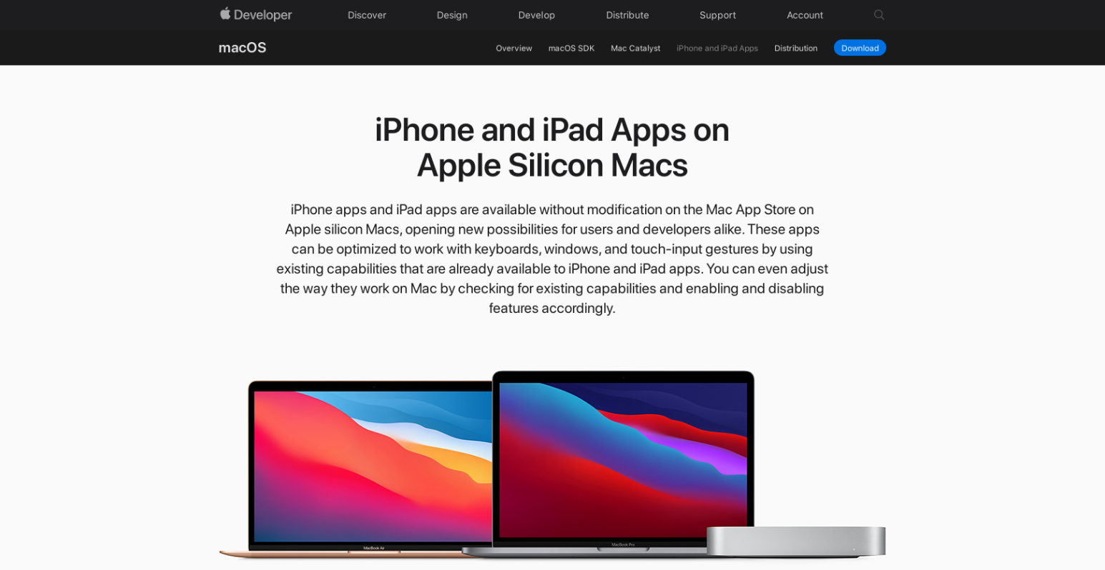
Officially supported 3.0
https://developer.apple.com/macos/iphone-and-ipad-apps/

Slide 30
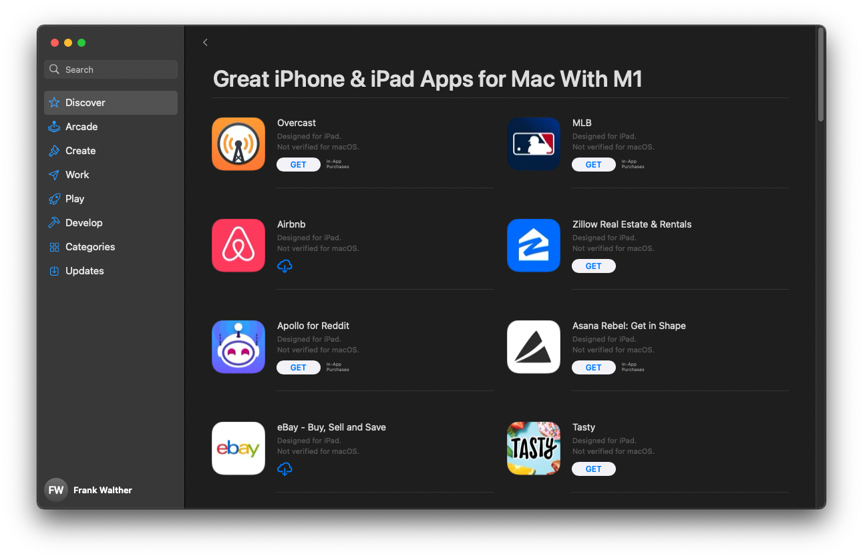
Officially supported 3.0

Slide 31
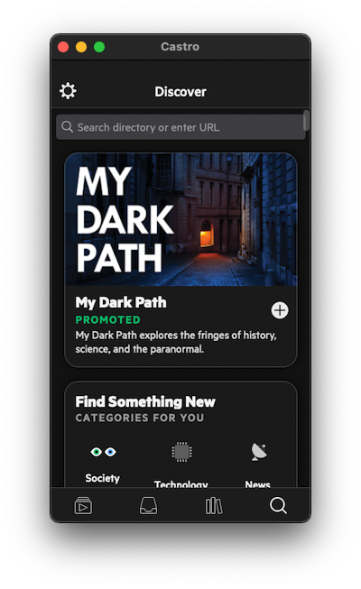
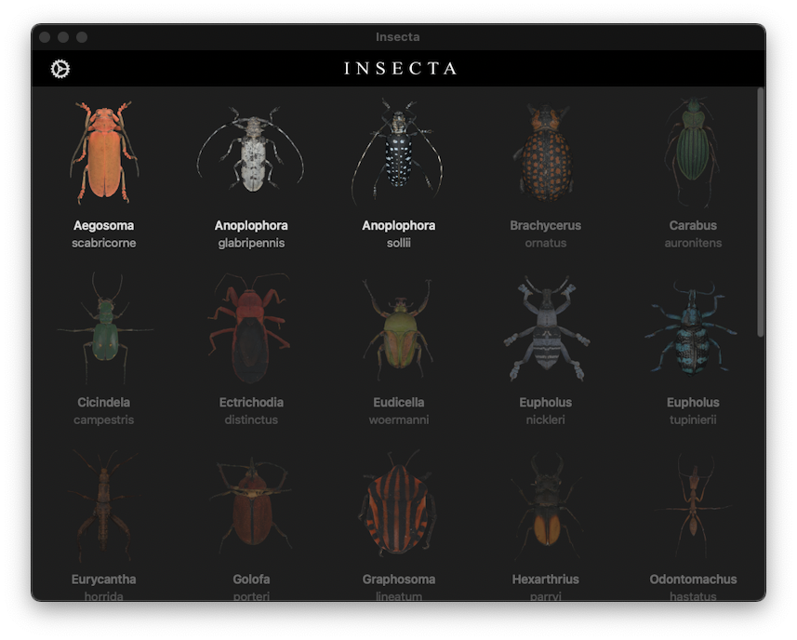
Officially supported 3.0

Slide 32
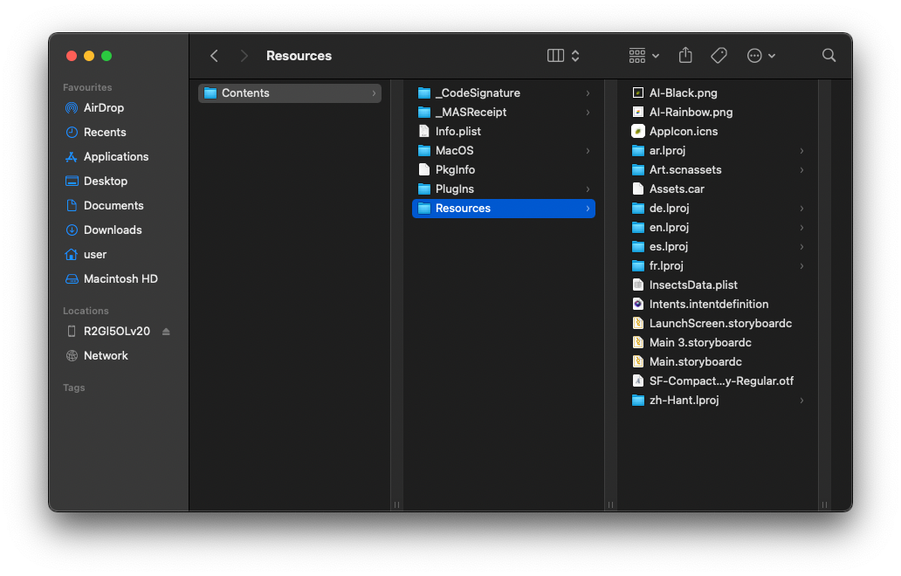
Probably just the .ipa?

Slide 33
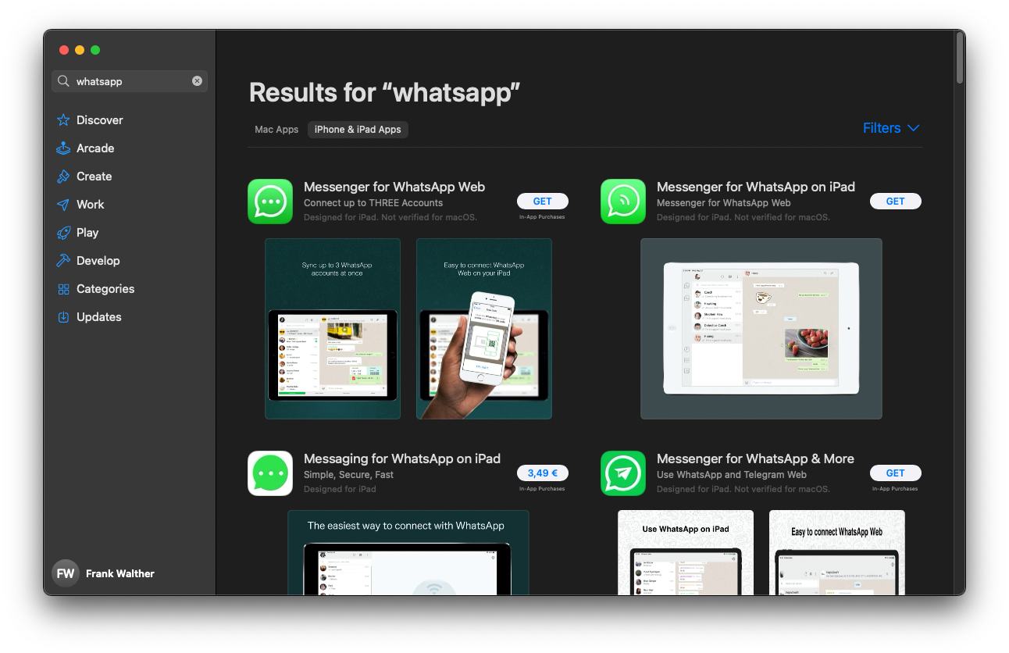
Not all of them, though

Slide 34
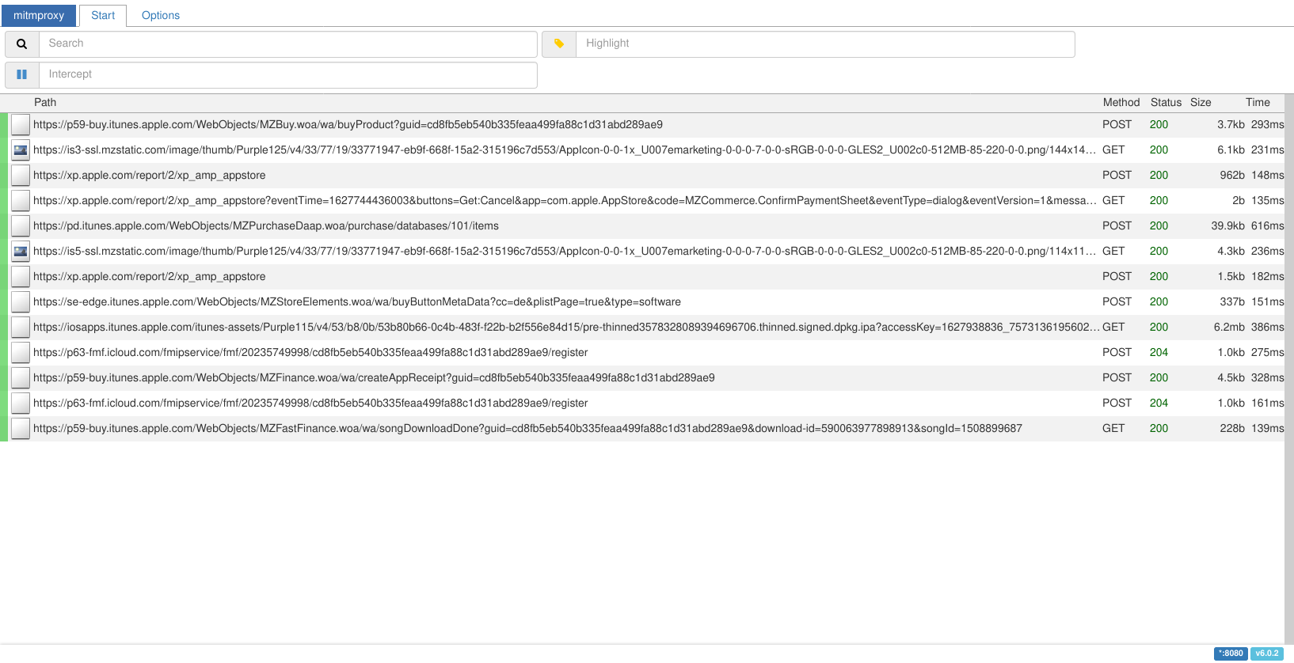
How does the App Store do it?

Slide 35
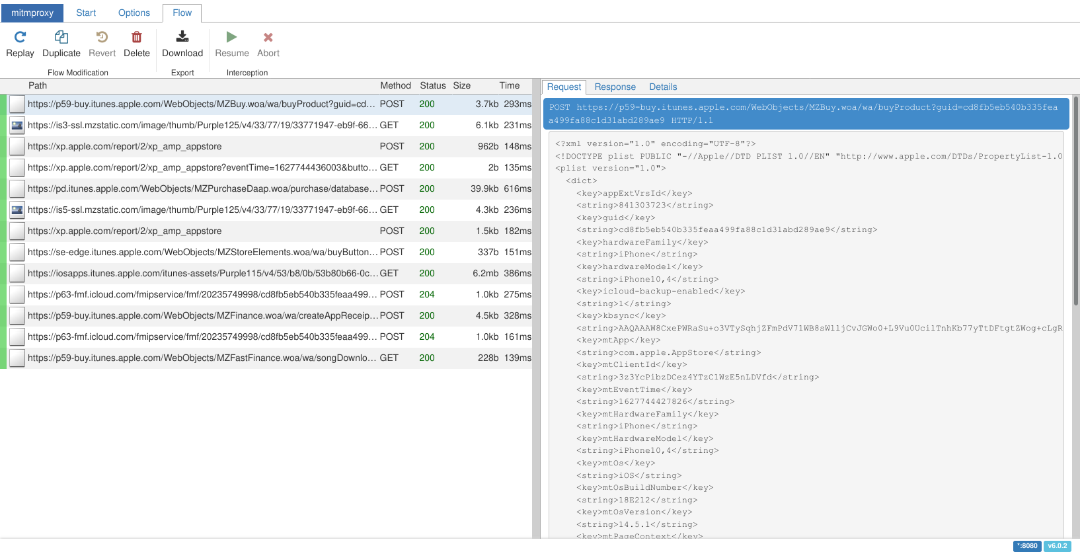
How does the App Store do it?

Slide 36
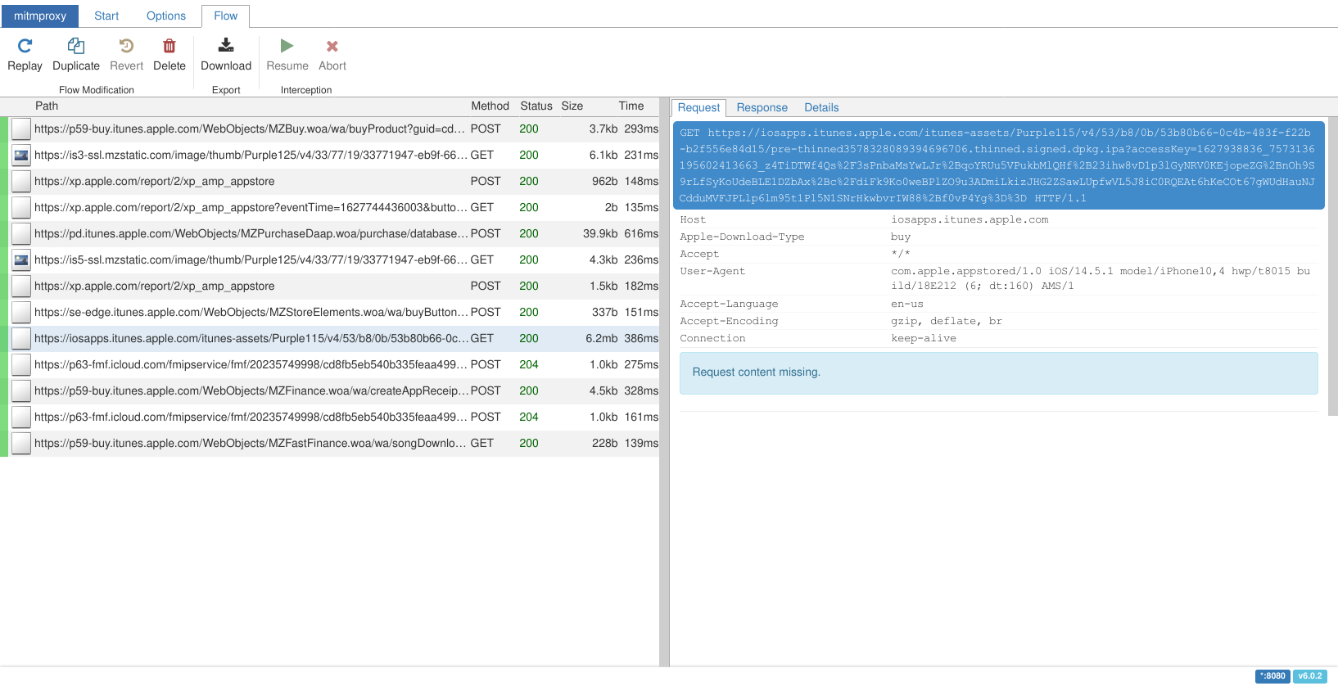
How does the App Store do it?

Slide 37
What do we actually need for the request?
<plist version="1.0"> <dict> <!-- [Not all parameters listed, some reordered.] --> <key>appExtVrsId</key> <string>841303723</string> <key>salableAdamId</key> <string>1508899687</string> <key>hardwareFamily</key> <string>iPhone</string> <key>hardwareModel</key> <string>iPhone10,4</string> <key>osVersion</key> <string>14.5.1</string> <key>kbsync</key> <string>AAQAAAW8CxePWRaSu+o3VTySqhjZFmPdV71WB8sWlljCvJGWo0+L9Vu0UcilTnhKb77yTtDFtgtZWog+cLgRrFg
5dyPoHbgK5LsSIRKTJ6fddbnPnklYXj/3F4CXwLI9xZwecRfiREfpu89yXK7T04q3L6fOLux6uPdNUmo+YaLvYPeZXfU1
Oh1HgDODF3lZH91duBHw2dV1AI0EztNJGm00ldTT5d8RwgVuWLcohiEksnguxd0tACECxYIpDtPL8PaY9ex4bNbj1y2xG
jBYUs0kR7wMHmCZZQeaeXCNs2qX+ZNNpBq+m4J1drkgQ+1WDtkKkVE4J5iw3j9bpiSwQfpc2KYm2B8Jhd0R/hZYRTDsV+
Vw0tG4QPcE9/zNq/KgRXp+yEBe6FL6WkKprg72ttDulrB/idwKy1Z6XUcLi1jdrHZV</string> </dict> </plist>

Slide 38
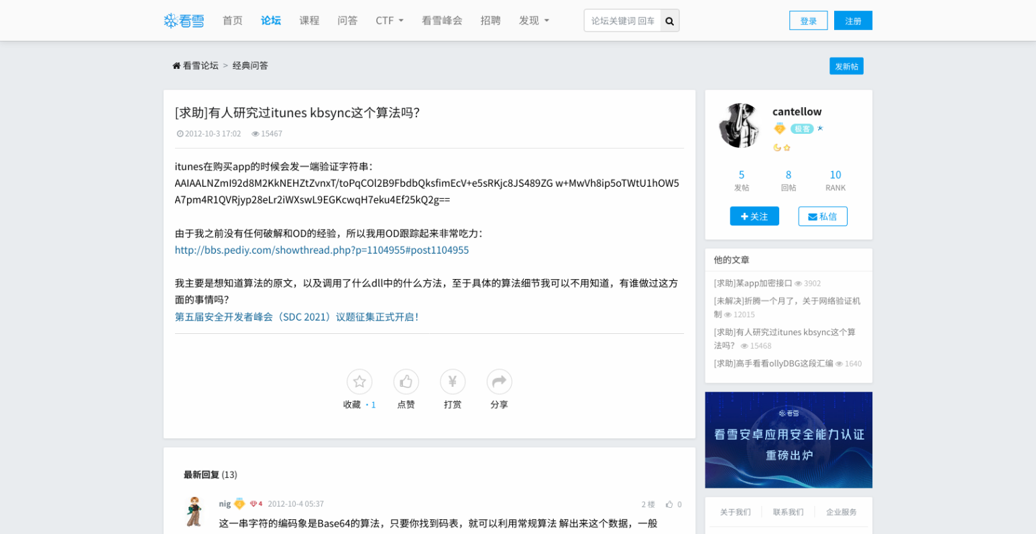
kbsync, you say?
https://bbs.pediy.com/thread-156752.htm

Slide 39
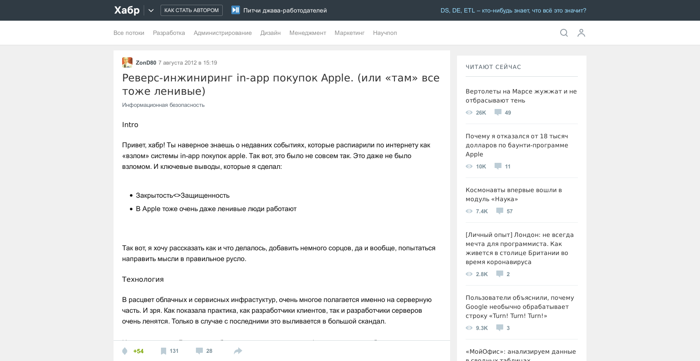
kbsync, you say?
https://habr.com/ru/post/149207/

Slide 40
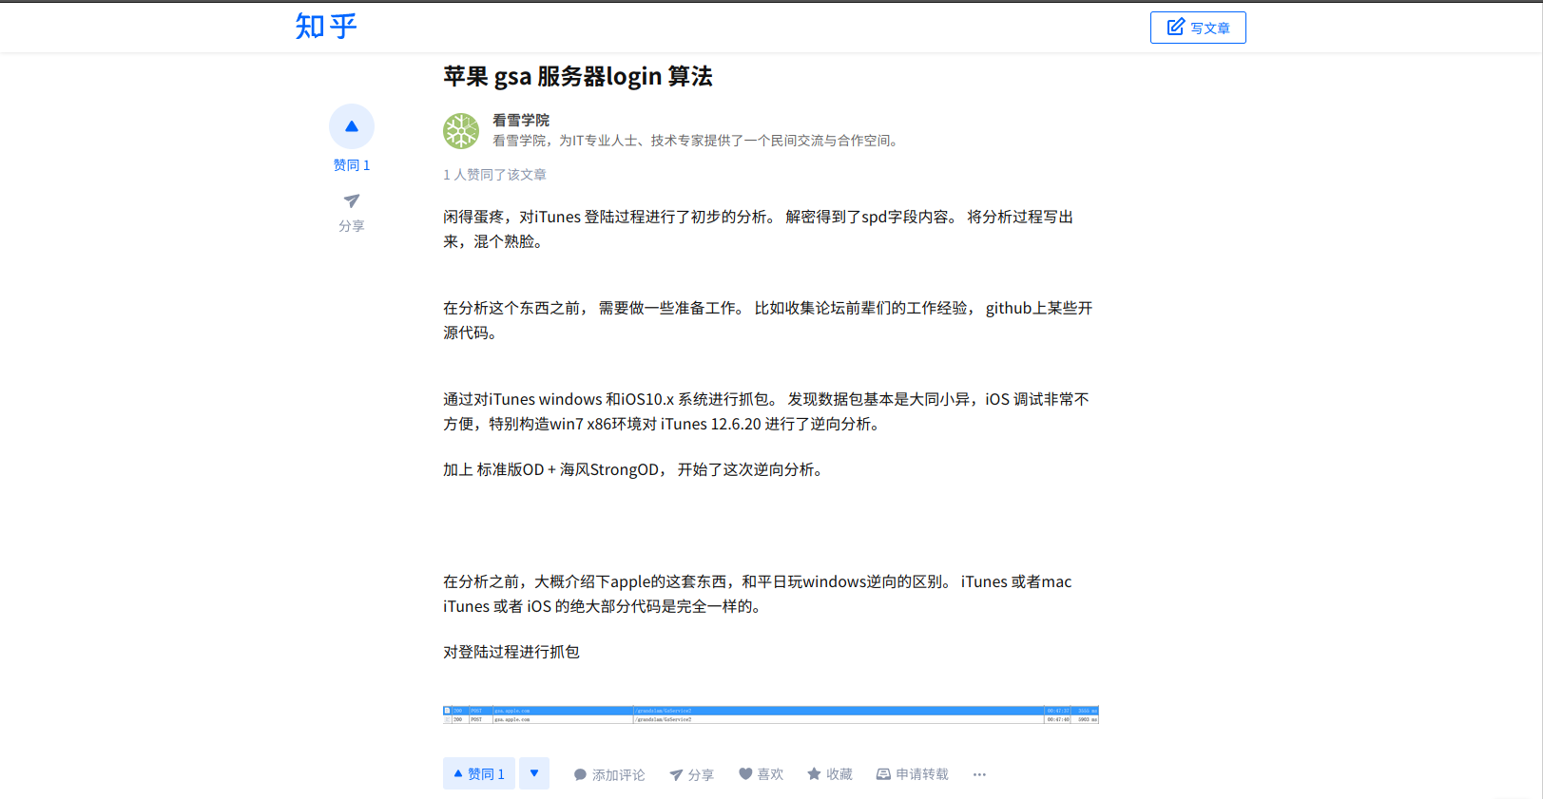
kbsync, you say?
https://www.zhihu.com/column/p/29278195

Slide 41
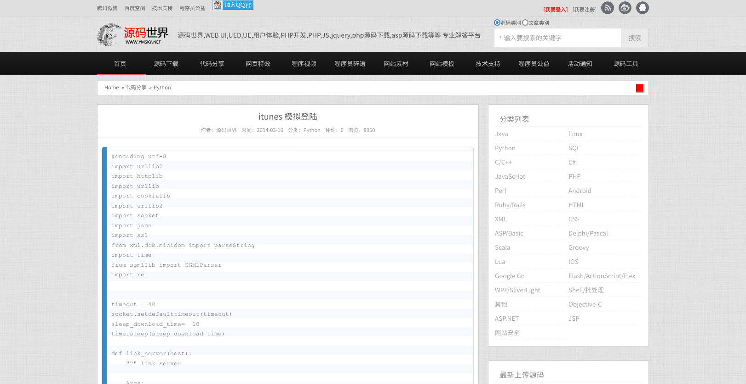
So close and yet so far…
http://www.ymsky.net/views/64756.shtml

Slide 42
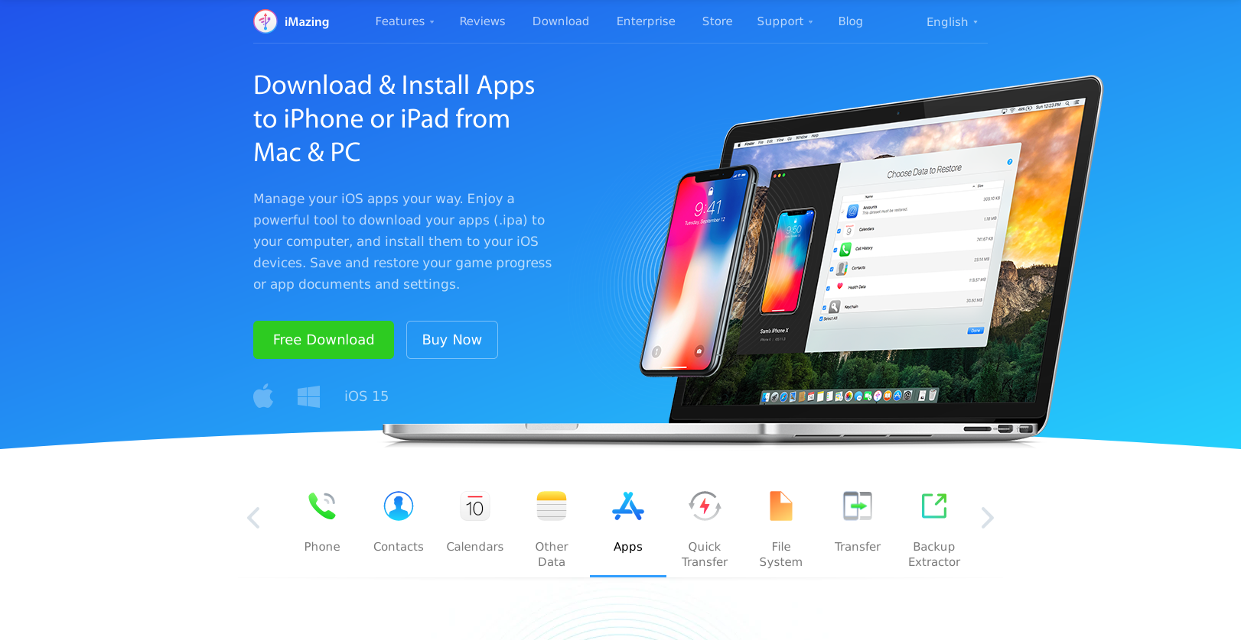
Some one else must have figured this out, right?
https://imazing.com/ios-app-management

Slide 43
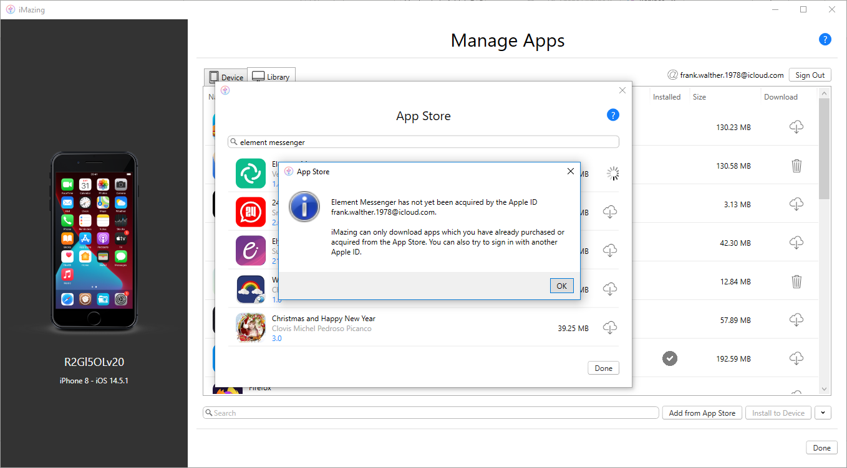
Not so iMazing, after all

Slide 44
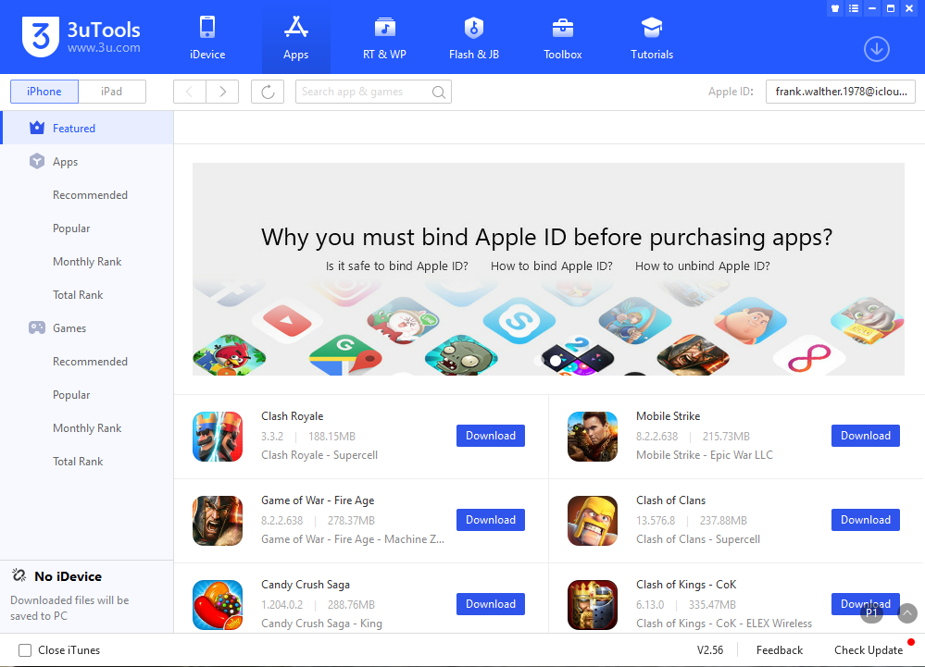
3uTools saves the day

Slide 45
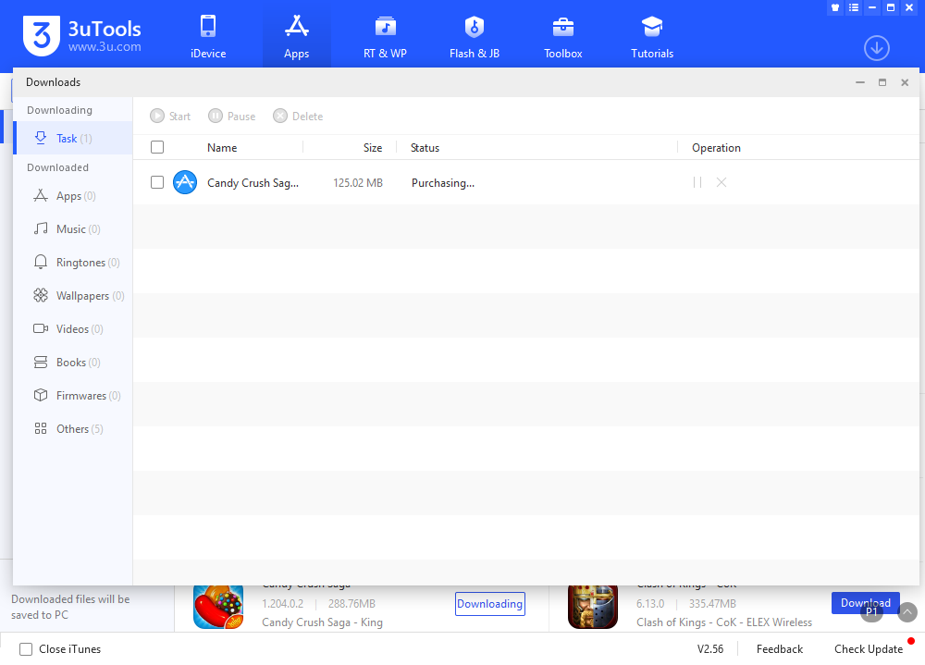
3uTools saves the day

Slide 46
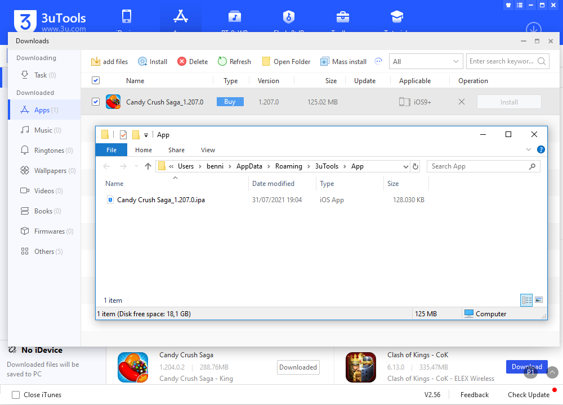
3uTools saves the day

Slide 47
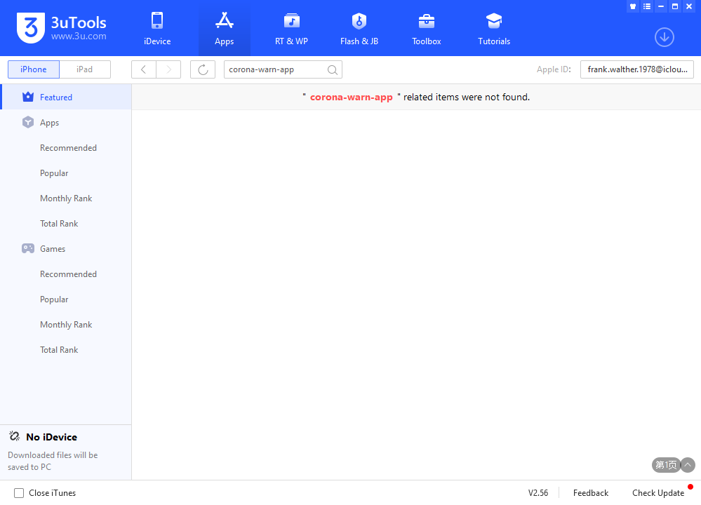
A final road block

Slide 48
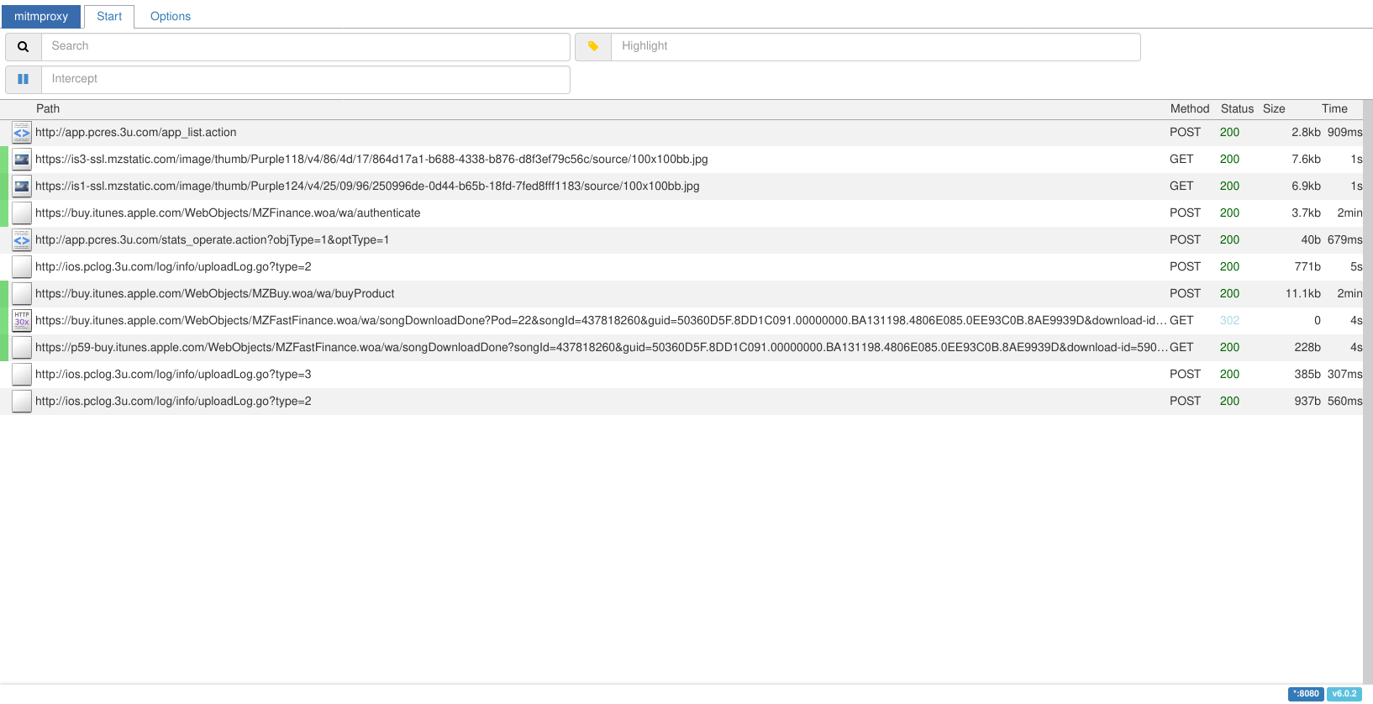
Or just a minor hurdle?

Slide 49
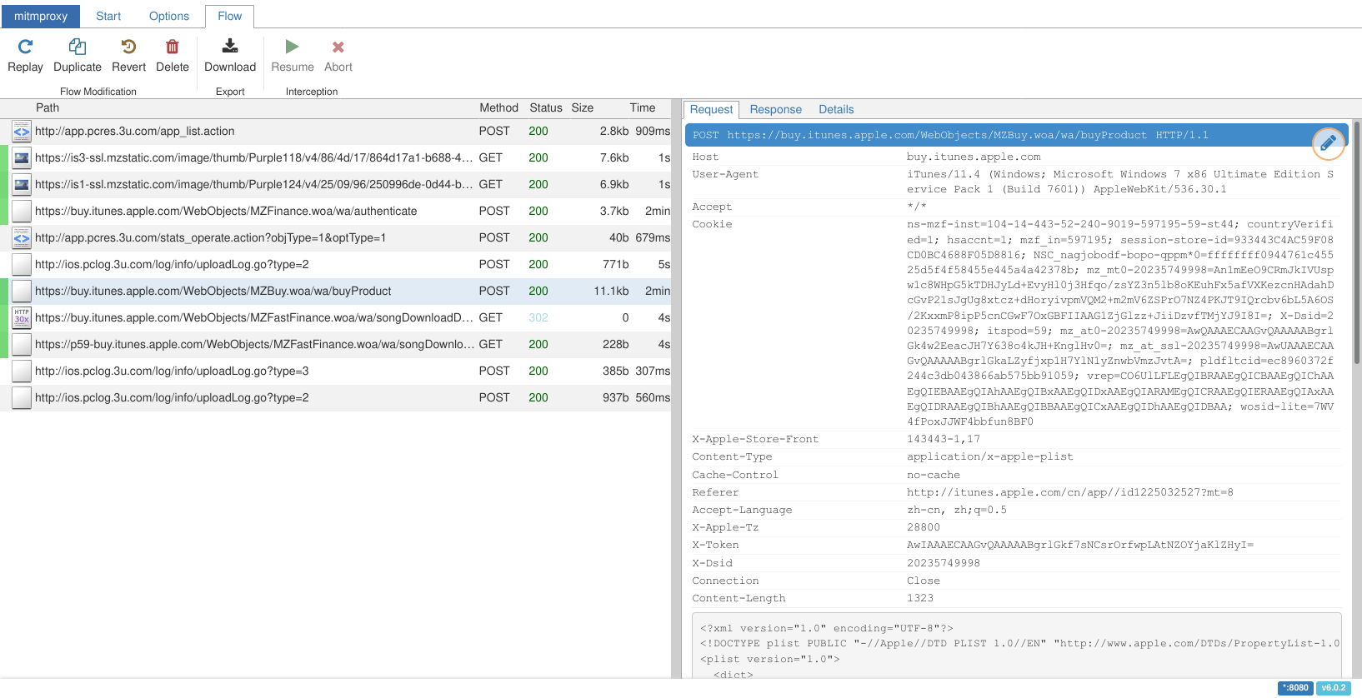
Doesn’t that request look familiar?

Slide 50
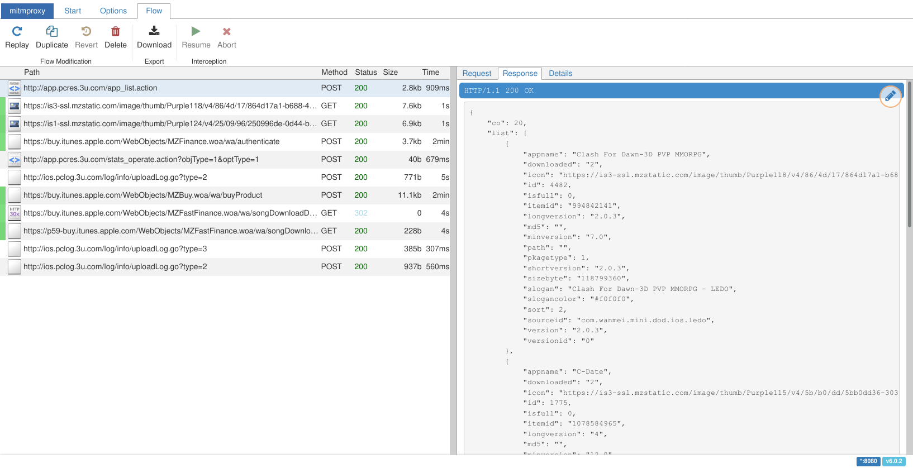
We’ve identified our hurdle

Slide 51
The only logical solution
def response(self, flow: http.HTTPFlow): if(flow.request.pretty_url == "http://app.pcres.3u.com/app_list.action"): i = int(flow.request.urlencoded_form.get("page")) - 1 apps = self.apps[0+i*20:20+i*20] res_apps = [{ "versionid": "0", "icon": f"https://via.placeholder.com/100?text={a['buyData']['bundle-id']}", "itemid": a['id'], "id": idx + i * 20, "slogancolor": "#f0f0f0", "appname": a['name'], "sourceid": a['buyData']['bundle-id'], "minversion": a['buyData']['minimum-os-version'], "sizebyte": a['buyData']['file-size'], "longversion": a['buyData']['minimum-os-version'], # […] } for idx, a in enumerate(apps)] res = { "success": True, "type": 104, "list": res_apps, "co": 20 } flow.response.content = json.dumps(res).encode("utf-8")

Slide 52
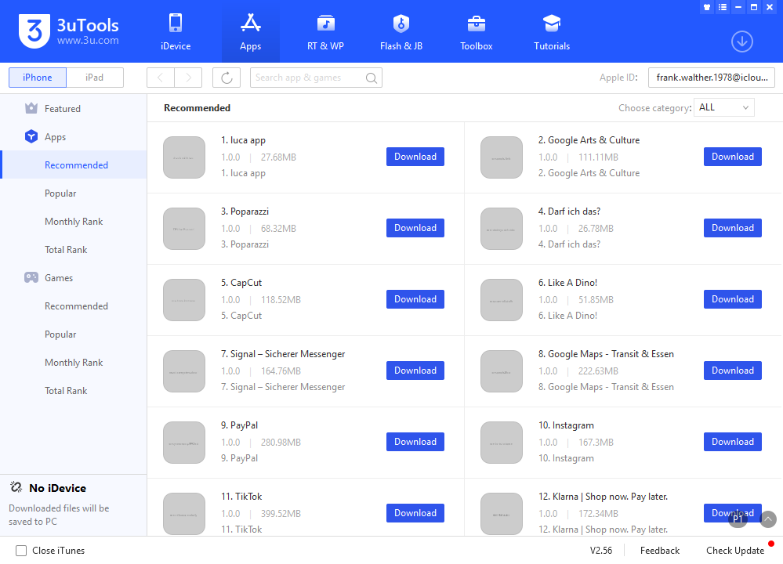
An improved 3uTools

Slide 53
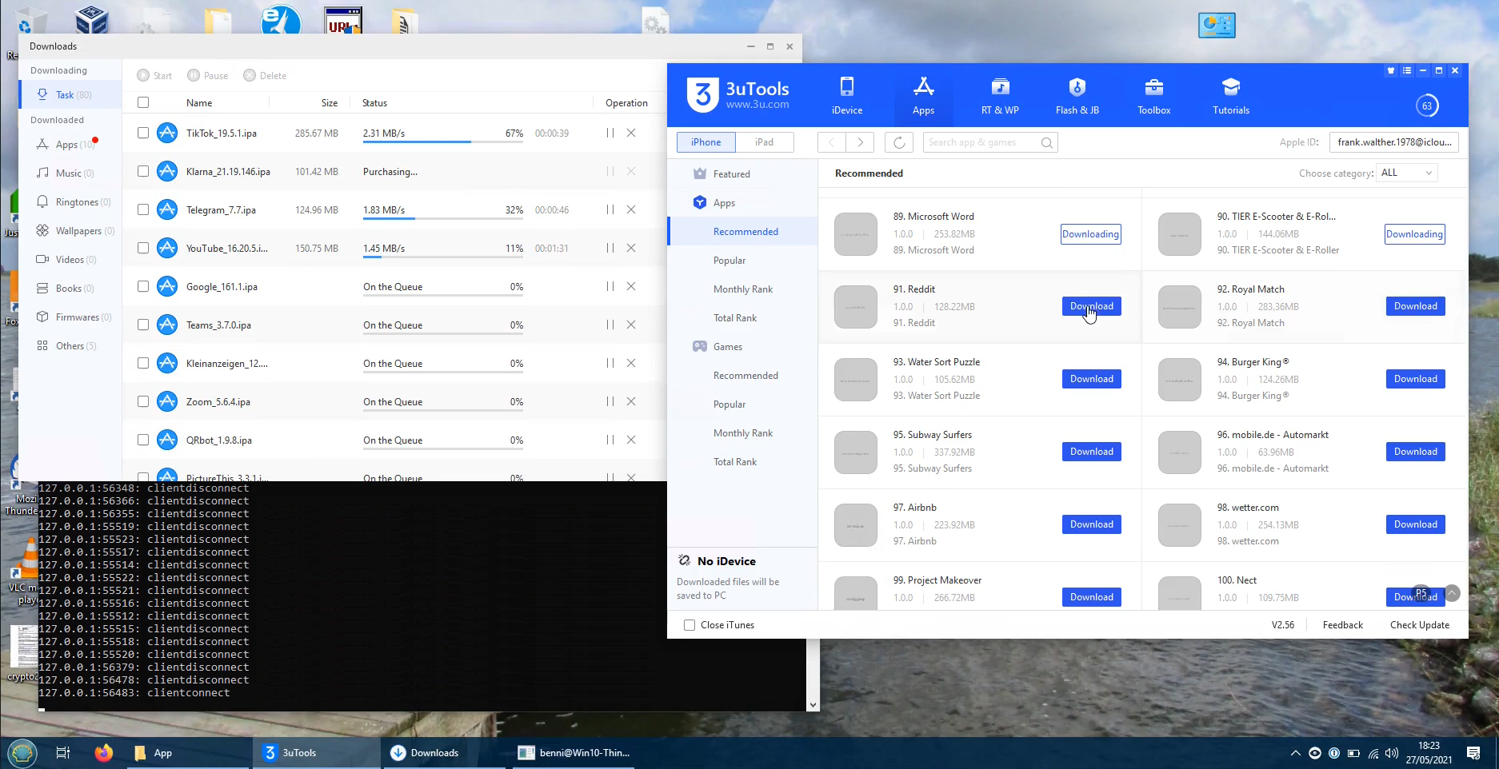
Click, click, click…

Slide 54
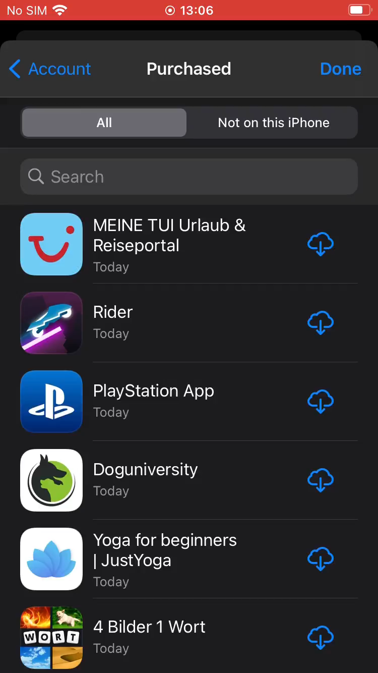
The reward

Slide 55

The (way) better reward

Slide 56
Automation
On macOS, Configurator can be scripted:
cfgutil install-app "<file.ipa>"
cfgutil remove-app "<bundle_id>"

Slide 57
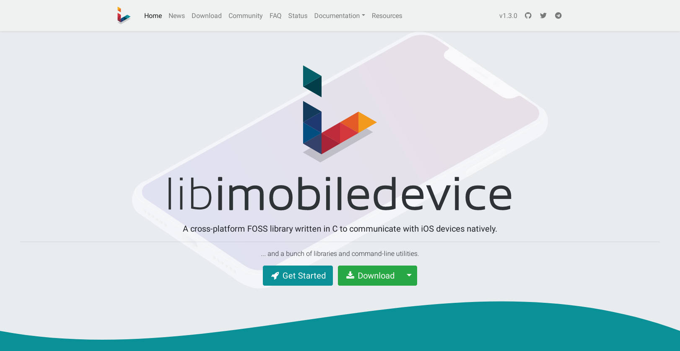
Automation
https://libimobiledevice.org/

Slide 58
Automation
On macOS, Configurator can be scripted:
cfgutil install-app "<file.ipa>"
cfgutil remove-app "<bundle_id>"
On Linux, we use libimobiledevice:
ideviceinstaller --install "<file.ipa>"
ideviceinstaller --uninstall "<bundle_id>"

Slide 59
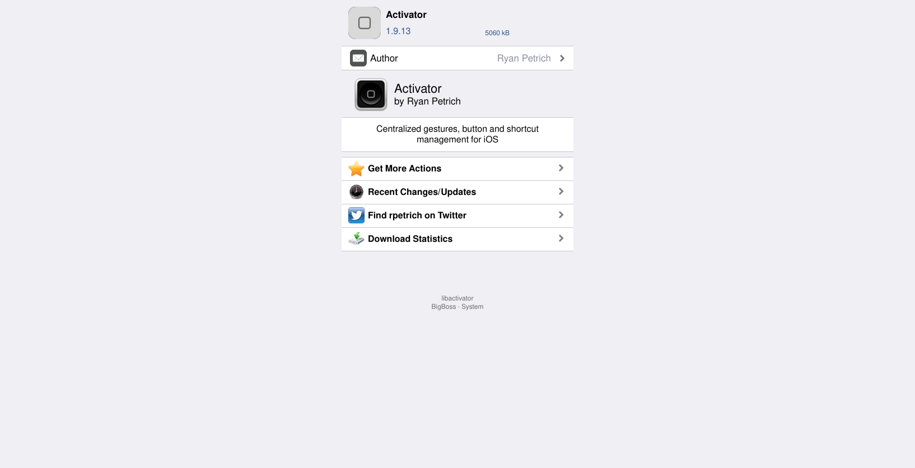
Automation
https://cydia.saurik.com/package/libactivator/

Slide 60
Automation
On macOS, Configurator can be scripted:
cfgutil install-app "<file.ipa>"
cfgutil remove-app "<bundle_id>"
On Linux, we use libimobiledevice:
ideviceinstaller --install "<file.ipa>"
ideviceinstaller --uninstall "<bundle_id>"
For the rest, we SSH into the device and use Activator:
activator send libactivator.system.homebutton
activator send "<bundle_id>"
activator listeners

Slide 61

Automatically granting permissions
https://objective-see.com/blog/blog_0x4C.html

Slide 62

Automatically granting permissions

Slide 63

Automatically granting permissions
auth_value == 0: permission not granted
auth_value == 2: permission granted

Slide 64

Automatically granting permissions

Slide 65
The available permissions
 | service | Label in Settings | Description
✓ | kTCCServiceCalendar | Calendars | “Access Your Calendar”
✓ | kTCCServiceAddressBook | Contacts | “Access Your Contacts”
✓ | kTCCServiceReminders | Reminders | “Access Your Reminders”
✓ | kTCCServicePhotos | Photos (All Photos) | “Access your photos”
✗ | kTCCServicePhotosAdd | Photos (Add Photos Only) | “Add to your Photos”
✓ | kTCCServiceMediaLibrary | Media & Apple Music | “Access Apple Music, your music and video activity, and your media library”
✓ | kTCCServiceBluetoothAlways | Bluetooth | “Find and connect to Bluetooth accessories. This app may also use Bluetooth to know when you’re nearby.”
☐ | kTCCServiceSpeechRecognition | Speech Recognition | “Access Speech Recognition”, “Speech data from this app will be sent to Apple to process your requests. This will also help Apple improve its speech recognition technology.”
✓ | kTCCServiceMotion | Motion & Fitness | “Access Your Motion & Fitness Activity”
✗ | kTCCServiceCamera | Camera | “Access the Camera”
✗ | kTCCServiceMicrophone | Microphone | “Access the Microphone”
✓ | kTCCServiceWillow | Home Data | “Access Your Home Data”

Slide 66
The available permissions (cont’d)
 | service | Label in Settings | Description
✗ | kTCCServiceUserTracking | Allow Tracking | “Track your activity across other companies’ apps and websites”
☐ | kTCCServiceWebKitIntelligentTracking Prevention | Allow Cross-Website Tracking | 0 means do allow, 2 means don’t allow
✓ | kTCCServiceLiverpool | no visible effect | maybe related to location access
✓ | kTCCServiceUbiquity | no visible effect | maybe related to iCloud
☐ | kTCCServiceSensorKitBedSensingWriting | no visible effect | “Add Data for Research Purposes”, “Record bed sensing Sensor & Usage data”
☐ | kTCCServiceGameCenterFriends | no visible effect | “Connect you with your Game Center friends”
☐ | kTCCServicePrototype3Rights | no visible effect | “Authorization to Test Service Proto3Right”
☐ | kTCCServicePrototype4Rights | no visible effect | “Authorization to Test Service Proto4Right”
☐ | kTCCServiceFallDetection | no visible effect | “Receive data from Apple Watch if a fall is detected and follow up in case help is needed”
☐ | kTCCServiceSiri | no visible effect | “Some of your %@ data will be sent to Apple to process your requests.”
☐ | kTCCServiceBluetoothPeripheral | no visible effect | “Make data available to nearby Bluetooth devices even when you’re not using the app”
☐ | kTCCServiceCalls | no visible effect | “Receive VoIP Calls in the Background”
✓ | kTCCServiceExposureNotification | Exposure Notifications | “Your iPhone can securely collect and share random IDs with nearby devices. The app can use these IDs to notify you if you may have been exposed to COVID-19. The date, duration, and signal strength of an exposure will be shared.”

Slide 67

ALL THE PERMISSIONS!

Slide 68
We’re missing the location permission
#/bin/bash # Adapted after: https://stackoverflow.com/a/53875499 and
https://stackoverflow.com/a/29548123 NEEDLE="com.bryceco.GoMap" find / -name '*.db' -print0 | while IFS= read -r -d '' file; do for X in $(sqlite3 $file .tables); do sqlite3 $file "SELECT * FROM $X;" | grep >/dev/null $NEEDLE && echo "Found in file '$file', table '$X'"; done done

Slide 69
It’s not quite as simple
Found in file '/private/var/mobile/Library/Caches/com.apple.appstored/storeUser.db', table
'launch_events'
Found in file '/private/var/mobile/Library/Caches/com.apple.appstored/storeUser.db', table
'purchase_history_apps'
Found in file '/private/var/mobile/Library/Caches/com.apple.appstored/storeUser.db', table
'current_apps_crossfire'
Found in file '/private/var/mobile/Library/TCC/TCC.db', table 'access'
Found in file '/private/var/mobile/Library/DuetExpertCenter/_ATXDataStore.db', table
'anchorModelTrainingData'
Found in file '/private/var/mobile/Library/DuetExpertCenter/_ATXDataStore.db', table
'appInfo'
Found in file '/private/var/mobile/Library/FrontBoard/applicationState.db', table
'application_identifier_tab'
Found in file '/private/var/mobile/Library/FrontBoard/applicationState.db', table
'kvs_debug'
Found in file '/private/var/mobile/Library/CoreDuet/Knowledge/knowledgeC.db', table
'ZOBJECT'
Found in file '/private/var/Keychains/Analytics/trust_analytics.db', table 'hard_failures'

Slide 70

Do we have to dust off our Objective C skills?
https://github.com/lucaIz-ldx/ForceReset/blob/de004718c1ebde9a80dc686040853089ceea20a0/Tweak.x#L151-L155

Slide 71

Enter Frida
https://frida.re/

Slide 72

Frida is great

Slide 73

Frida is (really!) great

Slide 74
Programmatically setting the location permission
To set the location permission using Frida: ObjC.classes.CLLocationManager .setAuthorizationStatusByType_forBundleIdentifier_( <value>, "<bundle_id>" );
Empirically determined values:
0: Ask every time, 2: Never, 3: Always, 4: While using the app
To check:
​// For the running app. ObjC.classes.CLLocationManager.authorizationStatus(); // For an arbitrary app. ObjC.classes.CLLocationManager .authorizationStatusForBundleIdentifier_("<bundle_id>");

Slide 75


(Truly) ALL THE PERMISSIONS!

Slide 76
Programmatically seeding the clipboard
Knowing that, seeding the keyboard is easy: ObjC.classes.UIPasteboard.generalPasteboard() .setString_("<string>");

Slide 77
This slide intentionally left blank.

Slide 78
Quick GDPR primer
concerns itself with the processing of personal data (Art. 2(1) GDPR)
both terms defined in Art. 4 GDPR:
personal data: “any information relating to an identified or identifiable natural person […]; [i.e.] one who can be identified, directly or indirectly, in particular by reference to an identifier such as a name, […], an online identifier or […] the physical, physiological, genetic, mental, economic, cultural or social identity […]” (Art. 4(1) GDPR)
processing: “any operation […] performed on personal data […], such as collection, recording, organisation, structuring, storage, adaptation or alteration, retrieval, consultation, use, disclosure by transmission, dissemination or otherwise making available, alignment or combination, restriction, erasure or destruction” (Art. 4(2) GDPR)
explicitly very broad terms, in essence any data that can somehow be connected to a person (including pseudonymously!) and that a company deals with in some way is covered by the GDPR

Slide 79
Quick GDPR primer
applicable EU-wide (Art. 3(1) GDPR), also applies to non-EU companies (Art. 3(2) GDPR) given they deliberately process the data of people in the EU in relation to the offering of goods and services; or in the case of the monitoring of the behaviour of people in the EU (→ tracking)
important for us: companies need a legal basis if they want to process our data (more on that later)

Slide 80
Enter Schrems II
recent (July 2020) Schrems II ruling by the European Court of Justice
generally, transferring data to country outside the EU is forbidden unless it there is an exception that allows it (Art. 44–50 GDPR)
previously, transfers to the USA usually based on Privacy Shield (or Safe Harbor before that), a so-called adequacy decision
however, Privacy Shield was invalidated by the ruling and cannot be used anymore
technically, it is still possible to legally transfer data to the US in narrow circumstances but the general consensus says it’s pretty much impossible [1], [2], [3]

Slide 81
Schrems II
in practice, so far barely any companies are fully compliant with this ruling due to the prevalence of US cloud providers etc., and enforcement is so far very limited
however, while the supervisory authorities are currently fairly lenient on this matter, they expect companies to review their transfers to the US and only keep those that are necessary and cannot be replaced
thus: tracking using US providers is most likely illegal, especially without user consent

Slide 82
Research question
How common is tracking in apps actually?
In particular, we are looking at tracking that happens without any user interaction (and thus, without consent).
We want to develop a tool that can analyse this automatically for a large number of apps.
We also manually looked at some of the interesting cases we discovered in the data.

Slide 83

https://play.google.com/store/apps/details?id=com.indeed.android.jobsearch

Slide 84
Indeed Job Search
POST https://t.appsflyer.com/api/v4/androidevent
?buildnumber=4.10.3&app_id=com.indeed.android.jobsearch
"af_timestamp": "1611209035694", "appsflyerKey": "ExLocXqS6j9TGyNebHQHrG", "operator": "T-Mobile", "network": "MOBILE", "timepassedsincelastlaunch": "-1", "open_referrer": "android-app://android", "af_v2": "e1089f09b150658adadbacd6f807c1947d072cb2", "uid": "1611209035909-2664535545820779500", "isGaidWithGps": "true", "lang_code": "en", "installDate": "2021-01-21_060319+0000", "app_version_code": "63766", "firstLaunchDate": "2021-01-21_060358+0000", "ivc": false, "model": "sdk_gphone_x86_64_arm64",
"lang": "English", "brand": "google", "batteryLevel": "77.0", "deviceType": "userdebug", "product": "sdk_gphone_x86_64_arm64",
"deviceData": { "sensors": [ { "sT": 1, "sVS": [0.7662141, 9.013549, 3.795387], "sN": "Goldfish 3-axis Accelerometer", "sV": "The Android Open Source Project", "sVE": [0.7662141, 9.013549, 3.795387] }, { "sT": 2, "sVS": [-17.875, 24.125, -38.4375], "sN": "Goldfish 3-axis Magnetic field sensor", "sV": "The Android Open Source Project", "sVE": [-17.875, 24.125, -38.4375] }, { "sT": 4, "sVS": [0, 0, 0], "sN": "Goldfish 3-axis Gyroscope", "sV": "The Android Open Source Project", "sVE": [0, 0, 0] } ],

Slide 85
Is that legal?
a conclusive list of legal bases is given in Art. 6(1)(a–f) GDPR; interesting for apps:
consent (lit. a)
performance of a contract (lit. b)
legitimate interest (lit. f), in that cases needs to weigh their interest against the fundamental rights of the user
in practice, processing in apps is usually based on consent or legitimate interest
but supervisory authorities say that consent is necessary for tracking in most cases [1]
recital 32 mandates conditions for consent: “Consent should be given by a clear affirmative act […] Silence, pre-ticked boxes or inactivity should not therefore constitute consent. […]”
remember: none of the apps received any user input, so obviously no consent was given

Slide 86

https://kidoz.net/

